Slide 1


Finding Frontiers
Travel Booking Application
Apoorva M
Ayush S
Prasanna CH

Slide 2

INDEX
Introduction
Dataset
Entities & Attributes
Conceptual Model
Logical Model
Application demo
Use cases
Area of improvements
Challenges

Slide 3

Introduction
Building a Centralized Travel Booking Management System
In the dynamic landscape of modern travel and tourism, the demand for efficient and centralized tools to manage tours and bookings is more pronounced than ever.
Our group project is dedicated to the development of an innovative online travel booking database system.
This initiative stems from our collective vision to create a comprehensive management tool that not only streamlines the booking process but also serves as a centralized hub for coordinating and organizing travel activities

Slide 4
DATASET
TABLE
Customer
Destinations
Places In Destination
Accommodations
Flights
Activities
Packages
Bookings
Reviews
Payment
Key tables created in a relational database to store information about users, flights, hotels, bookings, and other relevant data in an SQL database for a travel booking system

Slide 5
ENTITIES & ATTRIBUTES
Relationships
Relationship | Entity | Rule | Min | Max | Entity
accomodation-review | accomodation | has | 1 | M | review
 | review | Have | 1 | 1 | accomodation
flight-package | flight | Have | 1 | M | package
 | package | Has | 1 | 1 | flight
flight-booking | flight | has | 1 | M | booking
 | booking | Have | 1 | 1 | flight
flight-review | flight | has | 1 | M | review
 | review | have | 1 | 1 | flight
activity-package | activity | have | 1 | M | package
 | package | has | 1 | 1 | activity
activity-booking | activity | has | 1 | M | booking
 | booking | have | 1 | 1 | activity
activity-review | activity | has | 1 | M | review
 | review | have | 1 | 1 | activity
package-booking | package | has | 1 | M | booking
 | booking | have | 1 | 1 | package
package-review | package | has | 1 | M | review
 | review | have | 1 | 1 | package
booking-payment | booking | has | 1 | 1 | payment
 | payment | have | 1 | 1 | booking
Relationships
Relationship | Entity | Rule | Min | Max | Entity
customer-destination | customer | travel | 1 | M | destination
 | destination | travelled by | 1 | M | customer
customer-booking | customer | books | 1 | M | booking
 | booking | booked by | 1 | 1 | customer
customer-review | customer | reviews | 1 | M | review
 | review | reviewed by | 1 | 1 | customer
customer-payment | customer | pays | 1 | M | payment
 | payment | payed by | 1 | 1 | customer
destination-PlacesInDestination | destination | have | 1 | M | PlacesInDestination
 | PlacesInDestination | has | 1 | 1 | destination
destination-accomodation | destination | have | 1 | M | accomodation
 | accomodation | has | 1 | 1 | destination
destination-flights | destination | have | 1 | M | flight
 | flight | fly | 1 | M | destination
destination-package | destination | has | 1 | M | package
 | package | have | 1 | M | destination
accomodation-package | accomodation | have | 1 | M | package
 | package | has | 1 | 1 | accomodation
accomodation-booking | accomodation | has | 1 | M | booking
 | booking | have | 1 | 1 | accomodation

Slide 6
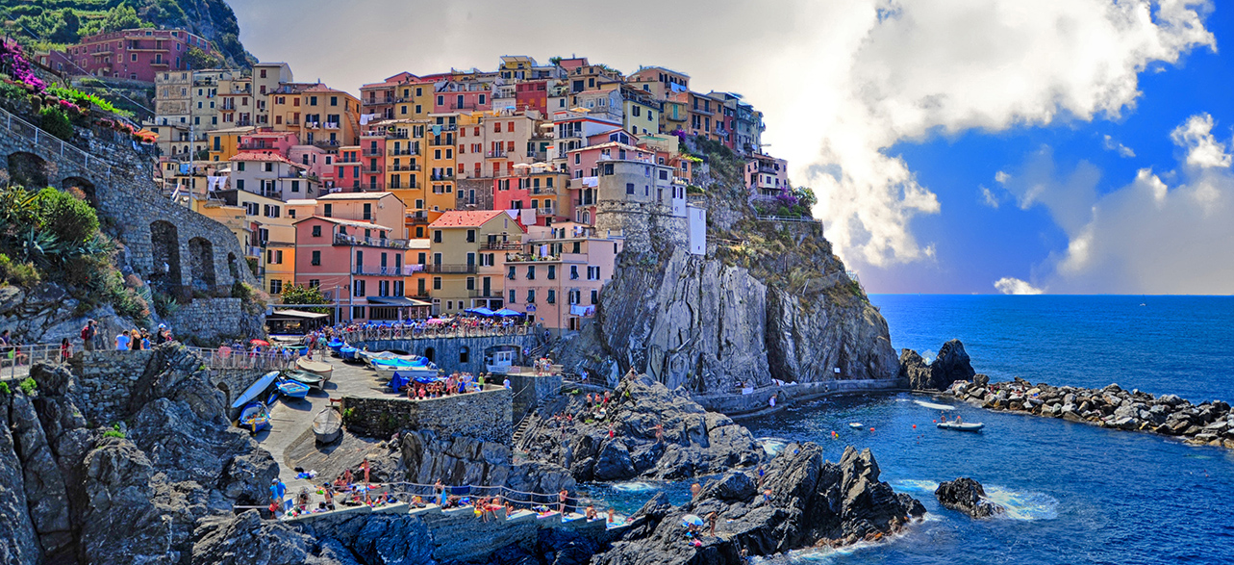
Conceptual & Logical models

Slide 7
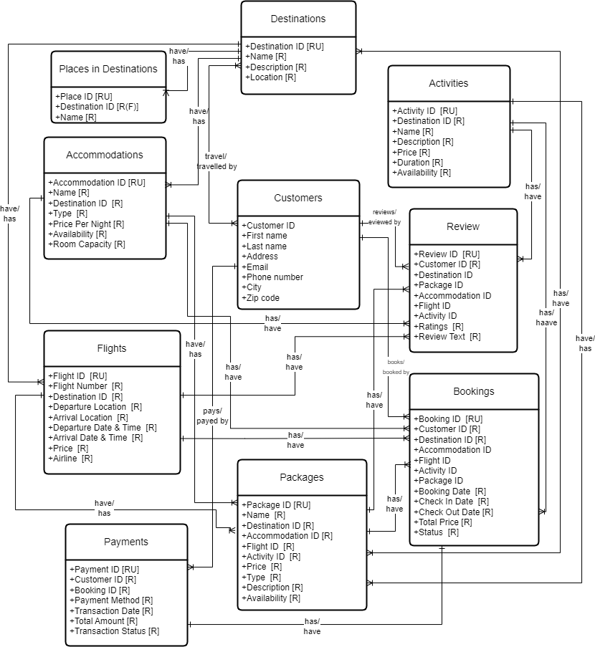
Conceptual representation of Entities and Attributes

Slide 8
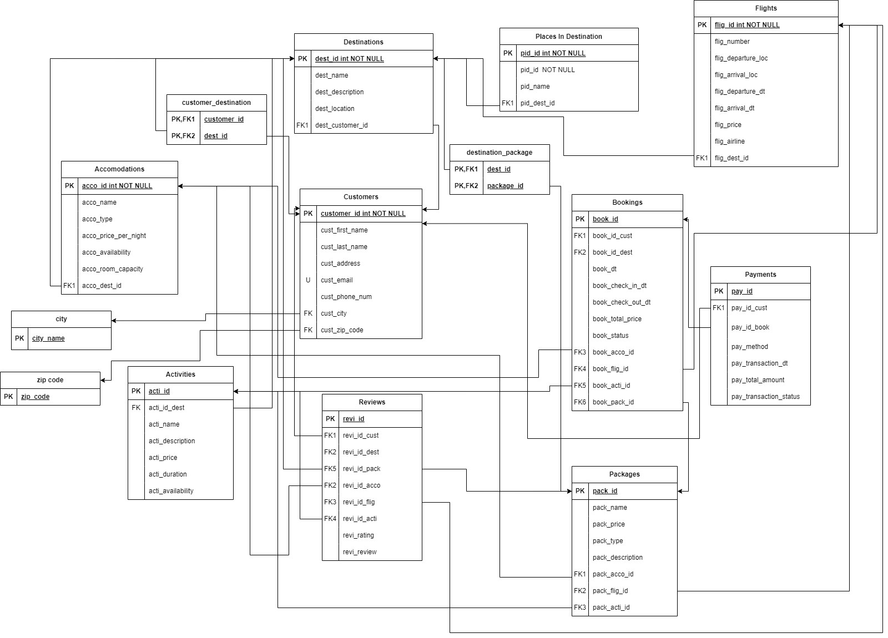
Logical representation of Entities and Attributes

Slide 9

APPLICATION DEMO
A demonstration of the User-interface and Backend workings of the application

Slide 10
USE CASES
FOR CUSTOMERS
FOR EMPLOYEES
Trip planning
Itinerary creation
Bookings and Reservation
Recommendations curated by data Visualization dashboard
Post trip features including reviews and ratings
Users' Itinerary
Confirmation functionality of Bookings and Reservations
Business Intelligence visualised by dashboard
Track of reviews and ratings

Slide 11
Area of Improvement
Data Source Optimization: Filtering and Sorting : Leverage SQL's capabilities to filter and sort data in Power Apps.
Optimize Power Apps Formulae: Reduce Formula Complexity: Simplify complex formulas that manipulate large datasets, as complex calculations can impact performance.
Parallel Loading: Parallelize Data Loading: Break down data retrieval into parallel tasks to take advantage of the Power Apps environment's ability to handle multiple requests simultaneously.

Slide 12
Challenges Faced
Initially, our attempt to establish a backend database involved utilizing SQL and Python.
Python requires more extensive coding, potentially slowing down development, whereas PowerApps, with its low-code environment, enables rapid development with less complexity.
Despite successfully creating a working backend, we opted to construct both the backend and frontend entirely from scratch with power apps.

Slide 13

THANK YOU!
Team Finding Frontiers
Email:
findingfrontiers@gmail.com

